Slide 1
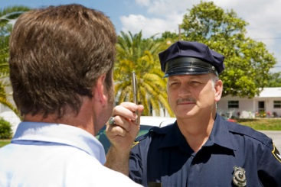



Session 7
Phase Three:
Pre-Arrest Screening

Slide 2

Learning Objectives
  Describe tasks and decision for Phase Three
  Define and describe nystagmus and concept
  of divided attention
  Describe role and limitations of preliminary
  breath tests
  Discuss arrest decision process

Slide 3
Phase Three:
Pre-Arrest Screening
Field Sobriety
Testing
?
Should
I Arrest?

Slide 4
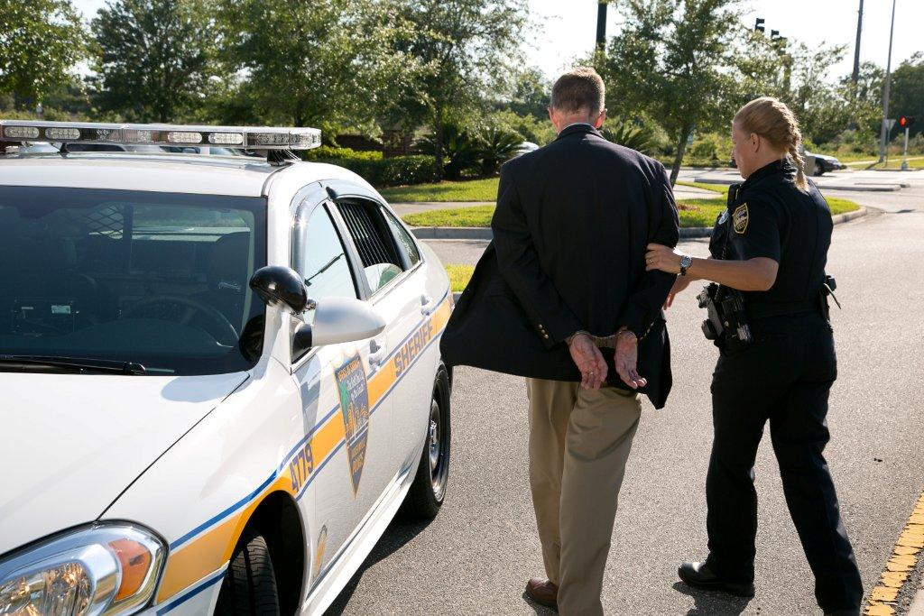
The Arrest Decision
DWI detection process concludes with arrest decision
Based on all evidence obtained during all three detection phases

Slide 5
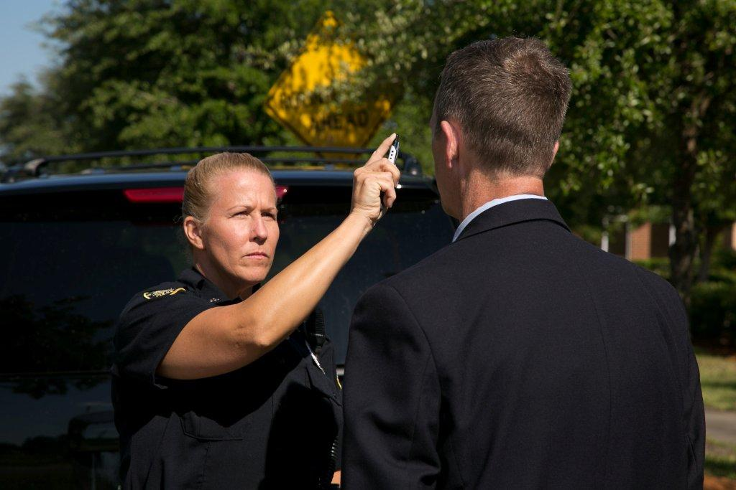
Nystagmus
Involuntary Jerking of the Eyes

Slide 6
Horizontal Gaze Nystagmus
Reliable
Involuntary
Noticeable
CNS Depressants, Inhalants, and Dissociative Anesthetics cause HGN

Slide 7
Horizontal Gaze Nystagmus Indications
Lack of Smooth Pursuit
Distinct and Sustained Nystagmus
at Maximum Deviation
Onset of Nystagmus Prior to 45 Degrees
88% accurate detecting subjects
≥ 0.08 BAC

Slide 8

Horizontal Gaze Nystagmus Demonstration

Slide 9
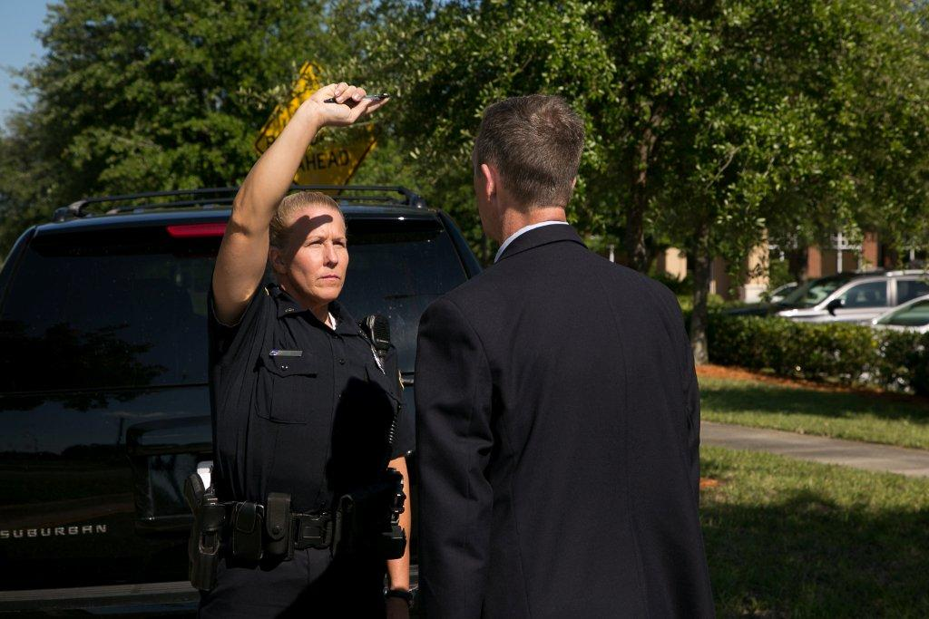
Vertical Gaze Nystagmus

Slide 10
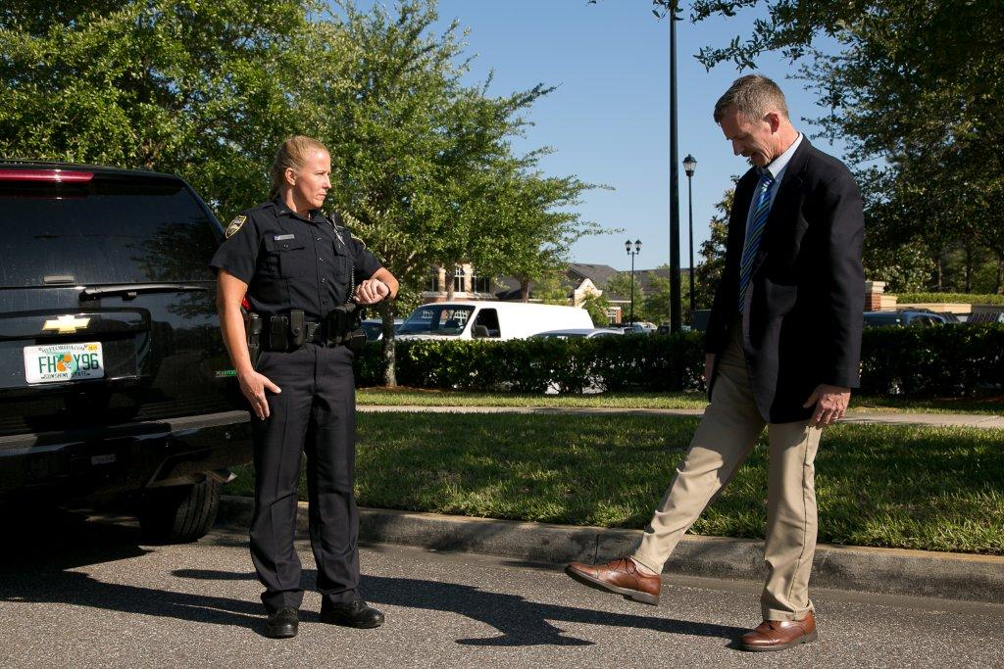
Divided Attention
Concentrating on more than one thing at a time
(mental tasks and physical tasks)

Slide 11
Typical Simultaneous Capabilities Required for Driving
Information processing
Short-term memory
Judgment/decision making
Balance
Steady, sure reactions
Clear vision
Small muscle control
Coordination of limbs

Slide 12
Psychophysical Tests
Focus on balance, coordination, information
processing, etc.
Observed as soon as face-to-face contact
and interview
Additional indicators observed as subject exits
SFSTs are most scientifically reliable

Slide 13
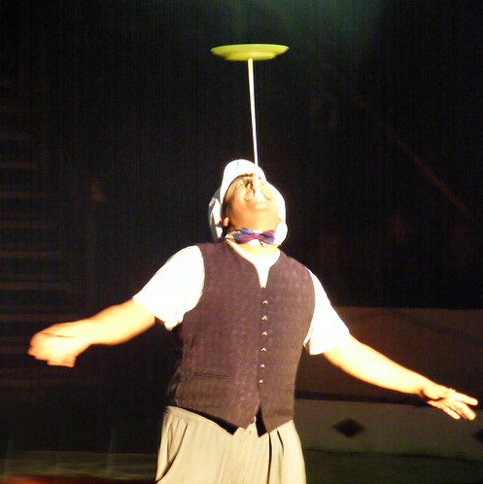
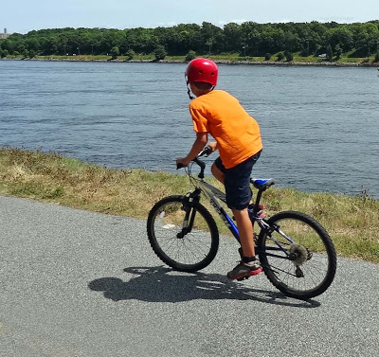
Simplicity
Field sobriety tests should be reasonably simple for the average person to complete as instructed when sober.

Slide 14
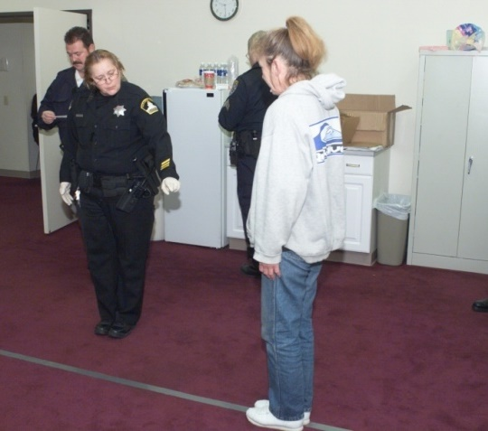
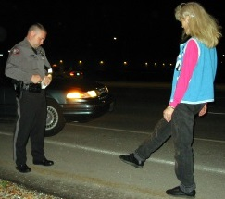
Two Divided Attention Field Sobriety Tests
Walk and Turn
One Leg Stand

Slide 15
Walk and Turn Overview
Validated by NHTSA
79% accurate detecting 0.08 BAC
Administer as instructed
Two stages:
  Instruction Stage
  Walking Stage

Slide 16
Walk and Turn
Instruction Stage
Divides subject’s attention
  Balancing
  Information processing
Subject stands with feet in heel-to-toe position
Arms at side
Listen to instructions

Slide 17
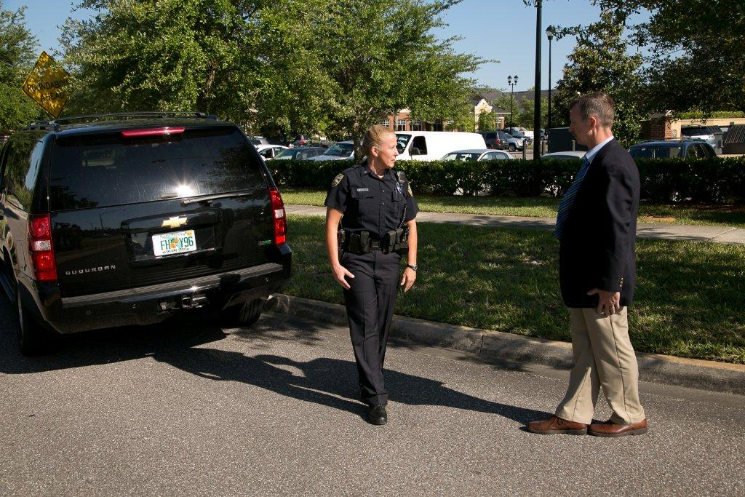
Walk and Turn
Walking Stage
Divides subject's attention
Balancing
Small muscle control
Short term memory

Slide 18
Walk and Turn Demonstration

Slide 19
Walk and Turn Test Clues
Cannot keep balance while listening to the instructions
Starts too soon
Stops while walking
Does not touch heel-to-toe
Steps off the line
Uses arm(s) to balance
Improper turn
Incorrect number of steps

Slide 20
One Leg Stand Overview
Validated by NHTSA
83% accurate detecting 0.08 BAC
Two stages:
  Instruction Stage
  Balance and Counting Stage

Slide 21
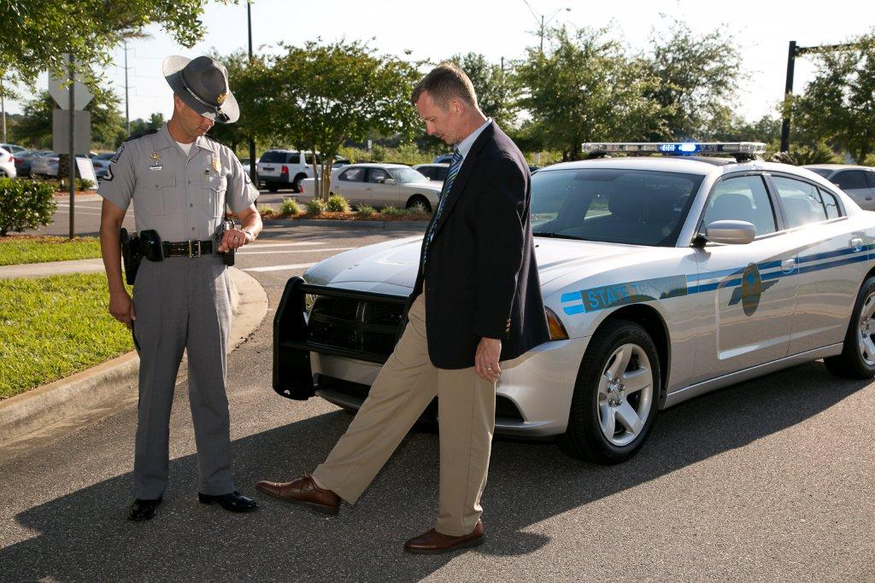
One Leg Stand
Instruction Stage
Divides subject's attention
Balancing
Information processing

Slide 22
Balance and Counting Stage
Divides subject’s attention
  Balancing task
  Information processing
30 second timing is important!

Slide 23
One Leg Stand Demonstration

Slide 24
One Leg Stand Test Clues
  Sways while balancing
  Uses arm(s) to balance
  Hopping
  Puts foot down

Slide 25
Preliminary Breath Testing Overview
Stage in pre-arrest screening
Demonstrate association of alcohol with observable evidence
Impairment established through sensory evidence
Does not indicate level of impairment

Slide 26
Preliminary Breath Testing Investigative Process
Not sole basis for a DWI arrest
Provides direct indication of alcohol impairment
Administer after SFSTs

Slide 27
Preliminary Breath Testing Advantages
Corroborate other evidence
Confirm officer’s observations
Confirm alcohol as cause of impairment
Help establish probable cause for DWI arrest

Slide 28
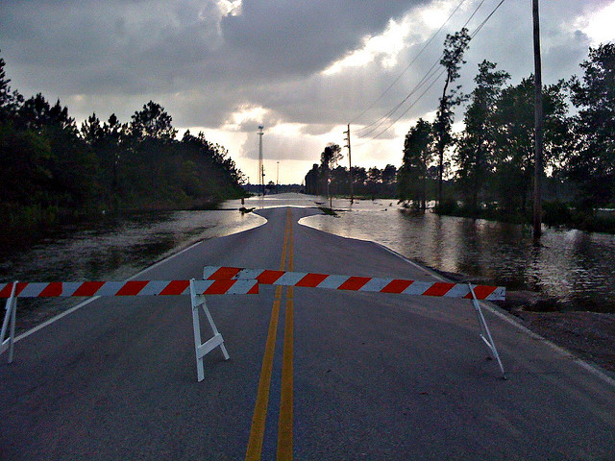
Preliminary Breath Testing Limitations
Evidentiary – vary with specific laws
Accuracy – must be used properly

Slide 29

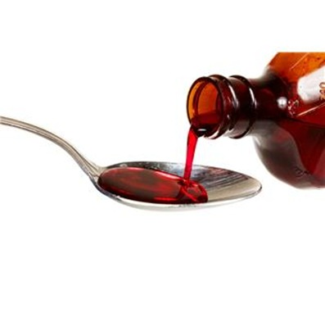

Possible Factors Affecting
High Preliminary Breath Testing
Residual mouth alcohol
Breath contaminants

Slide 30
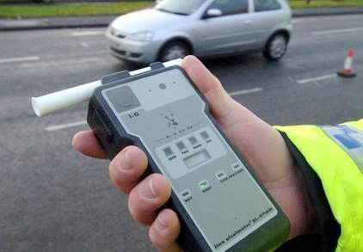
Possible Factors Affecting
Low Preliminary Breath Testing
Breath sample cooling
Breath sample composition

Slide 31
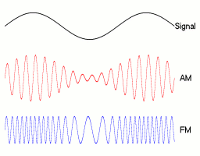
Possible Factor Affecting
Either High or Low Preliminary Breath Testing
Radio frequency interference

Slide 32





Arrest Decision
1
2
3
4
5
6
Initial observation of vehicle operation
Face to face observation and interview
Observation of the stop
Observation of the exit
Preliminary breath test
SFSTs

Slide 33
Questions?

Slide 34
Test Your Knowledge
The two major evidence gathering tasks of Phase Three are _________ and ________
The major decision in Phase Three is_______________________
The entire DWI detection process culminates in _______________________
Divided attention tests require the subject to_______________________

Slide 35
Test Your Knowledge
Among the mental and physical capabilities a person needs to drive safely are these four:
A.
B.
C.
D.
The two stages of the WAT are:
A.
B.

Slide 36
Test Your Knowledge
The two stages of the OLS are:
A.
B.
The purpose of PBT is________________
Two factors that produce high results on a PBT are:
A.
B.

Slide 37
Test Your Knowledge
Two factors that produce low results on a PBT are:
A.
B.

